Slide 1



Chowgacha - Jhenaidah Model: Challenges and Achievement
Dr. Md.Emdadul Haque
Senior Nation Consultant C -J model replication committee

Slide 2
Comparative data of health facilities of different country of the world
SL NO | Country | Per capita health Expenditure per year by Govt. ($) | Doctors per 10000 Population | Nurse per 10000 Population | Beds per 10000 population | Out of pocket expenditure %
01 | USA | 9536 | 25.5 | 99 | 37 | 11.08
02 | UK | 4356 | 28.0 | 84 | 30 | 14.79
03 | Malaysia | 386 | 12.8 | 34 | 18 | 36.67
04 | Sri Lanka | 118 | 7.3 | 17.5 | 31 | 38.43
05 | India | 63 | 7.3 | 20.4 | 09 | 65.06
06 | Nepal | 44 | 08 | 4.7 | - | 60.41
07 | Pakistan | 38 | 08 | 06 | 06 | 66.40
08 | Bangladesh | 37 | 3.9 | 03 | 03 | 67.00
From internet 2018

Slide 3



CHOWGACHA UPAZILA HEALTH COMPLEX
Chowgacha, Jessore.
Previous UHC
Present UHC

Slide 4
A Sub-district level Hospital with a Vision …
Maximum utilization of Govt.
resources with
honesty and sincerity.
Integrated approach of
Administration, Community
Leaders .
Providing Effective services
through improved
management system.

Slide 5
Background History of C-J Model
Program starts primarily in Chowgacha UHC in 1986
In 1996 effectively starts the model
In June 2008 ,MOH&FW declared the Chowgacha UHC as Model UHC of Bangladesh.
In 2010 D G of WHO recommended to replicate it.
Jhenaidah Sadar Hospital Model starts in 2012
C-J Model replicate in 2015 by MOHFW in 10 district hospital.
In2019 replicating by the order of PM office in 60 district & Upazilla hospital by DGHS

Slide 6



Blood donation program stared in 16 December, 1996 in Chowgacha UHC
A seminar held on basic information system at Chowgacha Degree College in June, 1997. DC Jessore was the chief guest .

Slide 7


Community supported volunteer working in ANC corner
Community Supported Volunteer Working as receptionist.

Slide 8
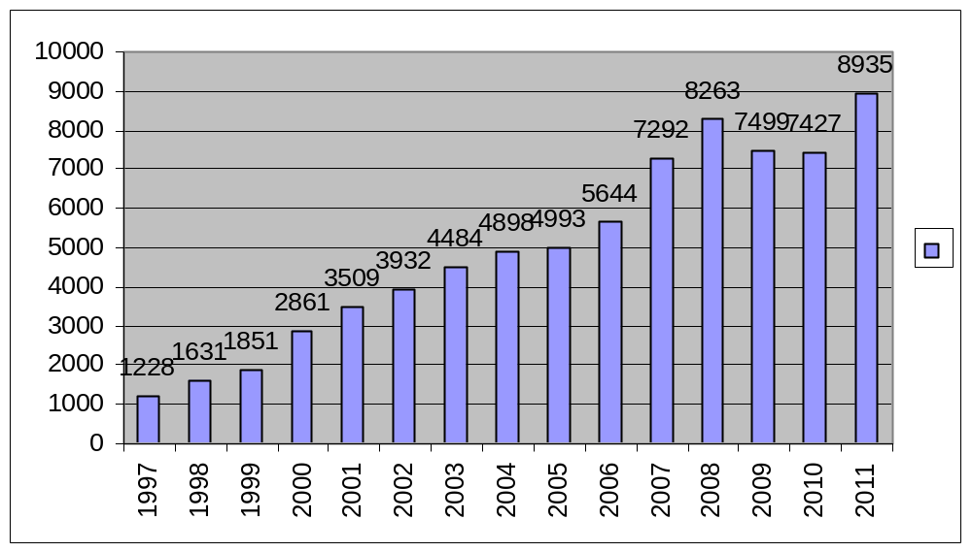
Upazila Health Complex
CHOWGACHA , JESSORE.
EOC Activities : 1997- 2011 (ANC First Visit)

Slide 9

Upazila Health Complex
CHOWGACHA , JESSORE.
EOC Activities : 1997- 2011 (Hospital Delivery )

Slide 10

Upazila Health Complex
CHOWGACHA , JESSORE.
EOC Activities : 2000 - 2011 (Caesarian Section)

Slide 11
Upazila Health Complex
CHOWGACHA , JESSORE.
Comparative Data of Delivery of best performing EOC center of Khulna Division in 2011
SL No | Name of institute | NVD | Vacuum Del. | V. Breech | C. Section | Total
01. | Chowgacha UHC | 3346 | 34 | 26 | 1007 | 4413
02. | Khulna Medical College Hospital | 1581 | 58 | 18 | 1356 | 3013
03. | 250 bed Hospital, Jessore | 1327 | 2 | 25 | 1498 | 2852
04. | 250 bed Hospital, Khustia | 1728 | 0 | 34 | 915 | 2677
05. | Jhenidah Sador Hospital | 1914 | 0 | 33 | 430 | 2337

Slide 12
Comparative Data of Delivery of best performing EOC center of Khulna Division in 2017
SL No | Name of institute | ANC | NVD | C. Section | Total
01 | Jhenaidah Sadar Hospital | 15360 | 1839 | 1143 | 2997
02 | 250 bed Hospital, Jessore | 13152 | 1327 | 1778 | 2967
03 | Chowgacha UHC | 18650 | 2163 | 759 | 2922
04 | Khulna Medical College Hospital | 6977 | 1455 | 1228 | 2683
05 | 250 Bedded Hospital, Kushtia | 4735 | 1595 | 919 | 2514

Slide 13
Chowgacha Health Complex – improvement evaluation (1995-2017)
Subject | 1995 | 1996 | 1997 | 2000 | 2003 | 2007 | 2011 | 2017
Bed Occupancy Rate % | - | - | 78.9 | 93.5 | 88.9 | 201 | 208 | 171
ANC (First Visit) | - | 16.3 (817) | 24.6 (1228) | 59 (2861) | 88 (4484) | 132 (7292) | 170 (8935) | 130 (6632)
Hospital Delivery Rate % | - | 2.1 (99) | 3.4 (151) | 6.4 (422) | 15 (661) | 38.1 (1899) | 98.4 (4413) | 66 (2932)
C-Section rate % | - | .02 (1) | 0 | 0.07 (3) | 0.8 (36) | 9.6 (473) | 22.5 (1107) | 17
Population Increase rate | 1.87 | 1.86 | 1.66 | 1.7 | 1.57 | - | 1.36 | 1.71
Maternal Mortality Ratio/100,000 live birth | 599 | 300 | 206 | 168 | 114 | 160 | 68 | 91
Neonatal mortaliy rate/ 1000 live birth | 42 | 47 | 42.4 | 23 | 28 | 21.5 | 18.2 | 16.6
Infant mortaliy rate/ 1000 live birth | 65 | 58 | 56 | 36 | 34 | 29.2 | 23.6 | 18.6
Under 5 mortaliy rate/ 1000 live birth | 78 | 67 | 62 | 44 | 43 | 33.3 | 25.7 | 21.1
Low birth weight rate(%) | - | - | 36.5 (74) | 15.2 (288) | 13.7 (636) | - | - | -

Slide 14
Upazilla Health Complex
CHOWGACHA , JESSORE.
COMMUNITY SUPPORTED MANPOWER
TOTAL :46
  Volunteers :26
  Cleaners & guards :16
  Others :04
  The remunerations come from
  Outsourcing :25
  Service provider :21
  The amount of remuneration ranging from 200/= To 8000/=tk. Per month depending upon the style of work, which costs a total of nearly 90,ooo/=Tk per month.

Slide 15
Achievement of Chowgacha Health Complex
In 2008, Chowgacha Health Complex declared as the model Upazilla health complex.
  EOC Beds increased from 11 to 41
  Chowgacha UHC became the best EOC center with 98.4% delivery rate in 2011
  Chowgacha UHC achieved MDG target in 2009.
  Chowgacha Health complex is awarded for best performance in EOC form 2005 to 2014.
  Achieve Health Minister s Award for its best performances and also for EOC.in2017
  The UHC starts upgrade to 100 bedded hospital.

Slide 16






Slide 17

100 kh¨v wewkó m`i nvmcvZvj, wSbvB`n

Slide 18
Challenges of the hospital in 2012
In secured hospital environment.
Performance of all activities was very low.
Very limited support staff.
Receiving money from the patients by non-govt. staff.
Waste management system was poor.
Monitoring meeting was not performed regularly

Slide 19




Innovative activities of Jhenaidah Sadar Hospital Page: 1
Reception room
Creation of nursing aid
Health education session
Community engagement

Slide 20




Internal Monitoring System
Starting of 5S KIZEN
Meting of health improvement committee
Monthly meeting schedule
Meting of community support committee

Slide 21




Use of direction sign, labeling of rooms, clean latrine and waist segregation
Use of direction sign
Labeling of rooms
waist segregation
Clean latrine

Slide 22




Use of color code, alignment of picture & continuous big cleaning day
Color code
Color code
Big Cleaning Day
Alignment of pictures

Slide 23




Changes in EOC & pediatric Ward
Before
After
Before
After

Slide 24
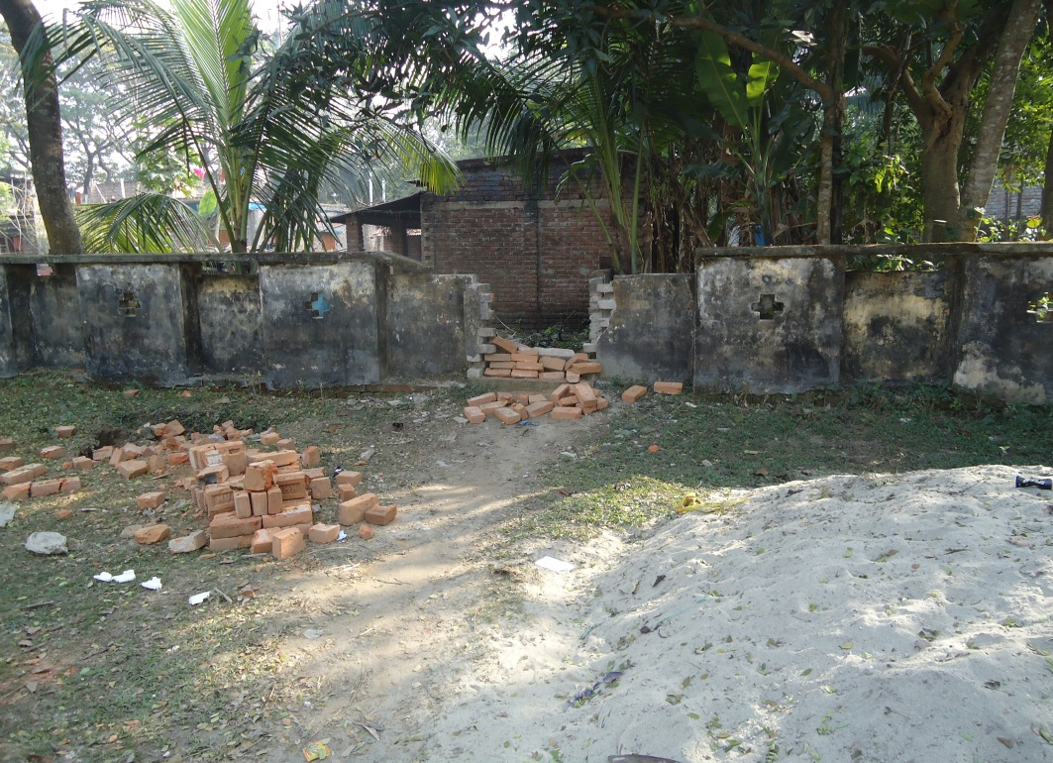
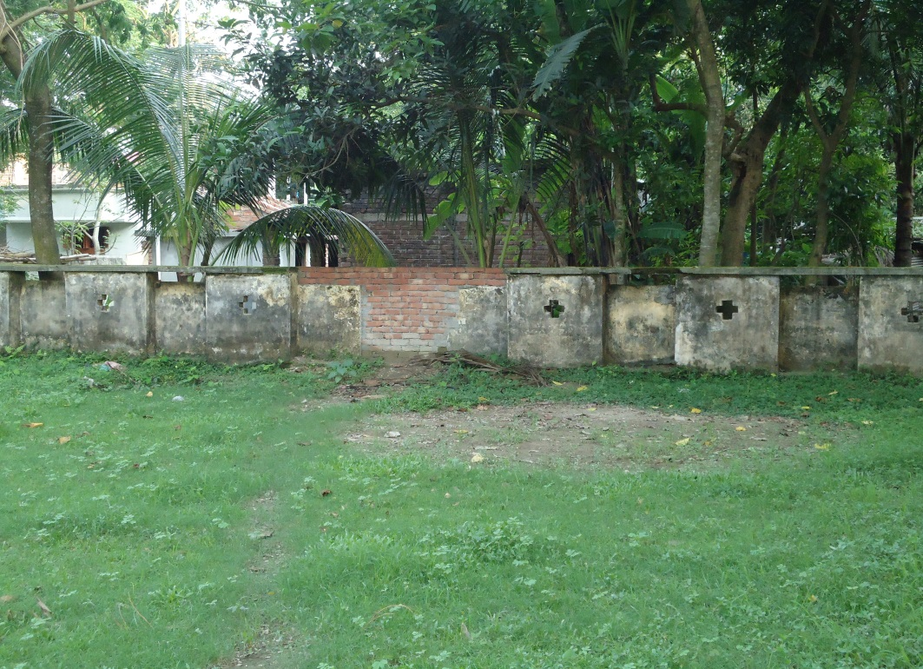



Local Govt. (Paurashava) Participation
Before
After
Before
After

Slide 25


KAIZEN in Jhenaidah Sadar Hospital
Recovered Valuable land after sixty years.
Arranged get man to control crowed in ward by Community support

Slide 26




Improved pediatric word by local initiative

Slide 27
Community Support System in Sadar Hospital
Human resource 56 (Cleaner 21, Ayah & ward boy 22, Guard 7, Volunteer 3, Trolley man 3 )
MP of Jhenaidah-2 supports 14, Zahedee foundation 12 , Mayor of Jhenaidah Paurasava 4, , doctors of Jhenaidah support 17 manpower.
Mayor of Jhenaidah Paurasava plays a role in security , cleanliness, renovation of pediatric word and arrange a mayoral conference.
Retired secretary provide a generator, Zahedee foundation an inter-com, mayor a biochemistry analyzer.

Slide 28

Sadar Hospital, Jhenaidah
Bed Occupancy Rate from 1998 to 2017

Slide 29
Emergency & Out Door, Indoor Service 1998 to 2017
Sadar Hospital, Jhenaidah

Slide 30
3 best performing EmOC Hospital in Khulna division - 2017
Sadar Hospital, Jhenaidah

Slide 31
Operation Service (Major) 2011 to 2017
Sadar Hospital, Jhenaidah

Slide 32
Achievements of Jhenaidah Sadar
Hospital
1. Active Community Participation is an example in Bangladesh.
2. Improved performance of all services.
3. Improved Cleanliness and Beautification of Campus.
4. Functioning of X-Ray service and Biochemistry investigation
5. Improved Security
6. Improved Financial Management
7. “Model ” is replicating in 11 district and 5 upazilla hospital
8. The hospital is awarded 7 times from 2013 to 2018.

Slide 33
Need to implement health related SDG
by 2030
In every community clinic 1 M.A
10 bedded hospital with 3 doctors, 12 nurses and paramedics in every union(primary healthcare centre)
100 bedded hospital In every upazilla
500 bedded hospital in every district.

Slide 34




Hospital Environment

Slide 35

Thank You
Notes:
35

Slide 36
Upazila Health Complex
CHOWGACHA , JESSORE.
EOC Activities : 1997- 2017 (Hospital Delivery )

Slide 37
Progress of Health Indicators in Chowgacha UHC (1996-2017)
Subject | 1996 | 1997 | 2000 | 2003 | 2007 | 2011 | 2017
Bed Occupancy Rate % | - | 78.9 | 93.5 | 88.9 | 201 | 208 | 171
ANC (First Visit) | 16.3 | 24.6 | 59 | 88 | 132 | 170 | 130
Hospital Delivery Rate % | 2.1 | 3.4 | 6.4 | 15 | 38.1 | 98.4 | 66
C-Section rate % | .02 | 0 | 0.07 | 0.8 | 9.6 | 22.5 | 17
Population Increase rate | 1.86 | 1.66 | 1.7 | 1.57 | - | 1.36 | 1.71
Maternal Mortality Rate/100,000 live birth | 300 | 206 | 168 | 114 | 160 | 68 | 91
Neonatal mortaliy rate/ 1000 live birth | 47 | 42.4 | 23 | 28 | 21.5 | 18.2 | 16.6
Infant mortaliy rate/ 1000 live birth | 58 | 56 | 36 | 34 | 29.2 | 23.6 | 18.6
Under 5 mortaliy rate/ 1000 live birth | 67 | 62 | 44 | 43 | 33.3 | 25.7 | 21.1

Slide 38
Comparative Data of Delivery of best performing EOC center of Khulna Division in 2017
SL No | Name of institute | ANC | NVD | C. Section | Total
01 | Ad-din Hospital Jessore. | 23981 | 640 | 3075 | 3715
02 | Jhenaidah Sadar Hospital | 15360 | 1839 | 1143 | 2997
03 | 250 bed Hospital, Jessore | 13152 | 1327 | 1778 | 2967
04 | Chowgacha UHC | 18650 | 2163 | 759 | 2922
05 | Khulna Medical College Hospital | 6977 | 1455 | 1228 | 2683
06 | 250 Bedded Hospital, Kushtia | 4735 | 1595 | 919 | 2514

Slide 39
Comparative Data of Delivery of best performing EOC center of Khulna Division in 2018
SL No | Name of institute | ANC | NVD | C. Section | Total
01 | Ad-din Hospital Jessore. | 25329 | 616 | 3444 | 4060
02 | Jhenaidah Sa dar Hospital | 12690 | 1795 | 887 | 2690
03 | 250 bed Hospital, Jessore | 12871 | 1517 | 1573 | 3106
04 | Chowgacha UHC | 18229 | 1945 | 790 | 2756
05 | Khulna M. C. Hospital | 4122 | 1517 | 1256 | 2870

Slide 40
Upazila Health Complex
CHOWGACHA , JESSORE.
EOC Activities : 2000 - 2017 (Caesarian Section)

Slide 41
Comparative Data of EOC services in Ad-Din Hospital Jessore from 2016- 2018,
SL No | Year | ANC | NVD | C. Section | Total
01 | 2016 | 23014 | 600 | 2715 | 3315
02 | 2017 | 23981 | 628 | 3015 | 3703
03 | 2018 | 25329 | 661 | 3444 | 4060

Slide 42
Background History of Community Engagement C-J model
In 1986, UHC is extended to nearby public library and opened 6 bedded indoor and started EPI, with the help of Upazilla Parishad.
In 1994, health complex shifted to new 31 bedded hospital, with 6 bedded labour ward.
UHFPO opened 4 special activities headed by medical officers in Feb. 1996
From January 1997 to 2000 JICA assistance in Frontline MCH Program
< Special activities>
ANC-Corner
Basic EOC service
Under 5 corner for under 5 children
Monthly birth and death record

Slide 43
C-J model Contd.
Form November 2000 started Comprehensive EOC program.
From April 2007 Demand Side Financing (DSF) program started.
Hospital is declared as model health complex on 20 June 2008 by MOH&FW
Chowgacha health complex Model is replicable through out the country declared by D.G. WHO on 8th March 2010.
Major Killer Disease (NCD) prevention program starts in 1st January-2011.
Government started to upgrade to 100 bed hospital

Slide 44
Background history of Jhenaidah Model
2012 | Starting of Model activities.
2013 | Kaizen Role Model Award for Model .
2014 | Jhenaidah team visits Satkhira Sadar Hospital, Awarded second prize for TQM
2015 | Ministry initiates Piloting of District-level Modelling and achieving the best prize for TQM.
2016 | Replication of Jhenaidah Model in 10 district hospital&5 Upazilla UHC. Awarded, Health Ministers Award and Best performance Award for EOC.
2017 | Awarded, Health Ministers Award and Best performance Award for EOC.
2019(15 Jan) | Started to replicate in 20 district & 40 upazilla hospital byDGHS

Slide 45
Issue should be addressed for development of services in Ad-Din Hospital Jess ore .
1.Attendance of the service provider.
2 Client satisfaction .
3. Risk. management.
4.Doucumentation of records –specially history taking ,monitoring of patient.
Operation of patient in deep night –delayed in action.
Quality of services in delivery specially use of partograph.

